Slide 1
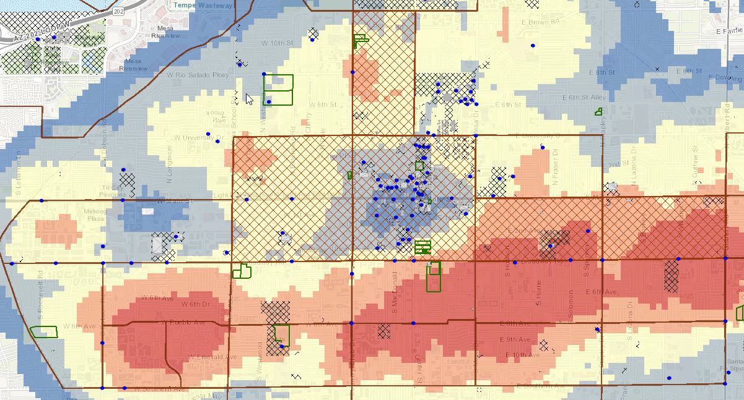
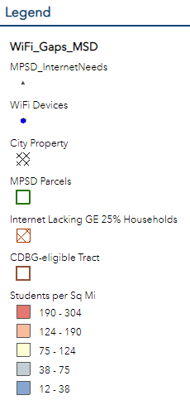
2020 Internet Need
CDBG LMI Census Tracts (2015) with MPS Family Internet Need (2020) and US Communities Survey Internet Need (2017)

Slide 3
Fiber Companies
COX Communications
Gigapower (AT&T Fiber)
Google Fiber
Lumen
Ubiquity

Slide 4
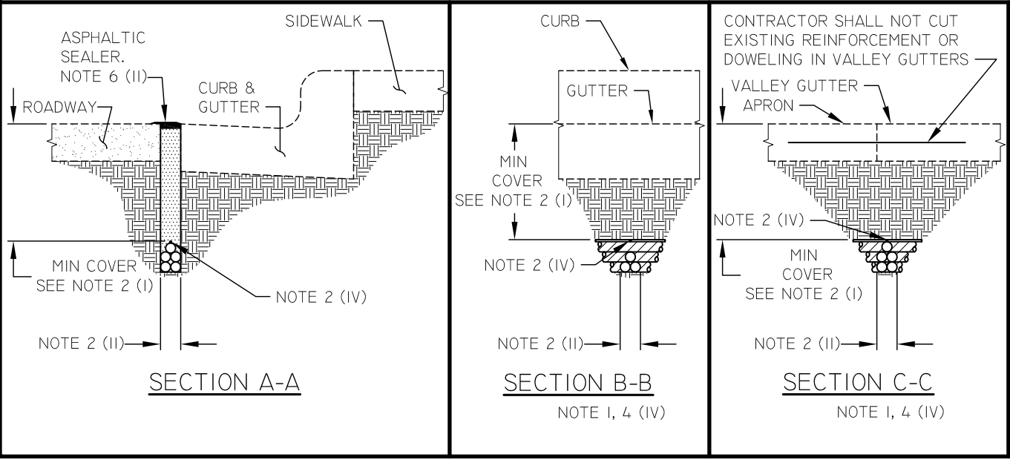
Micro-Trenching
City of Mesa - Right of Way Management Group

Slide 5
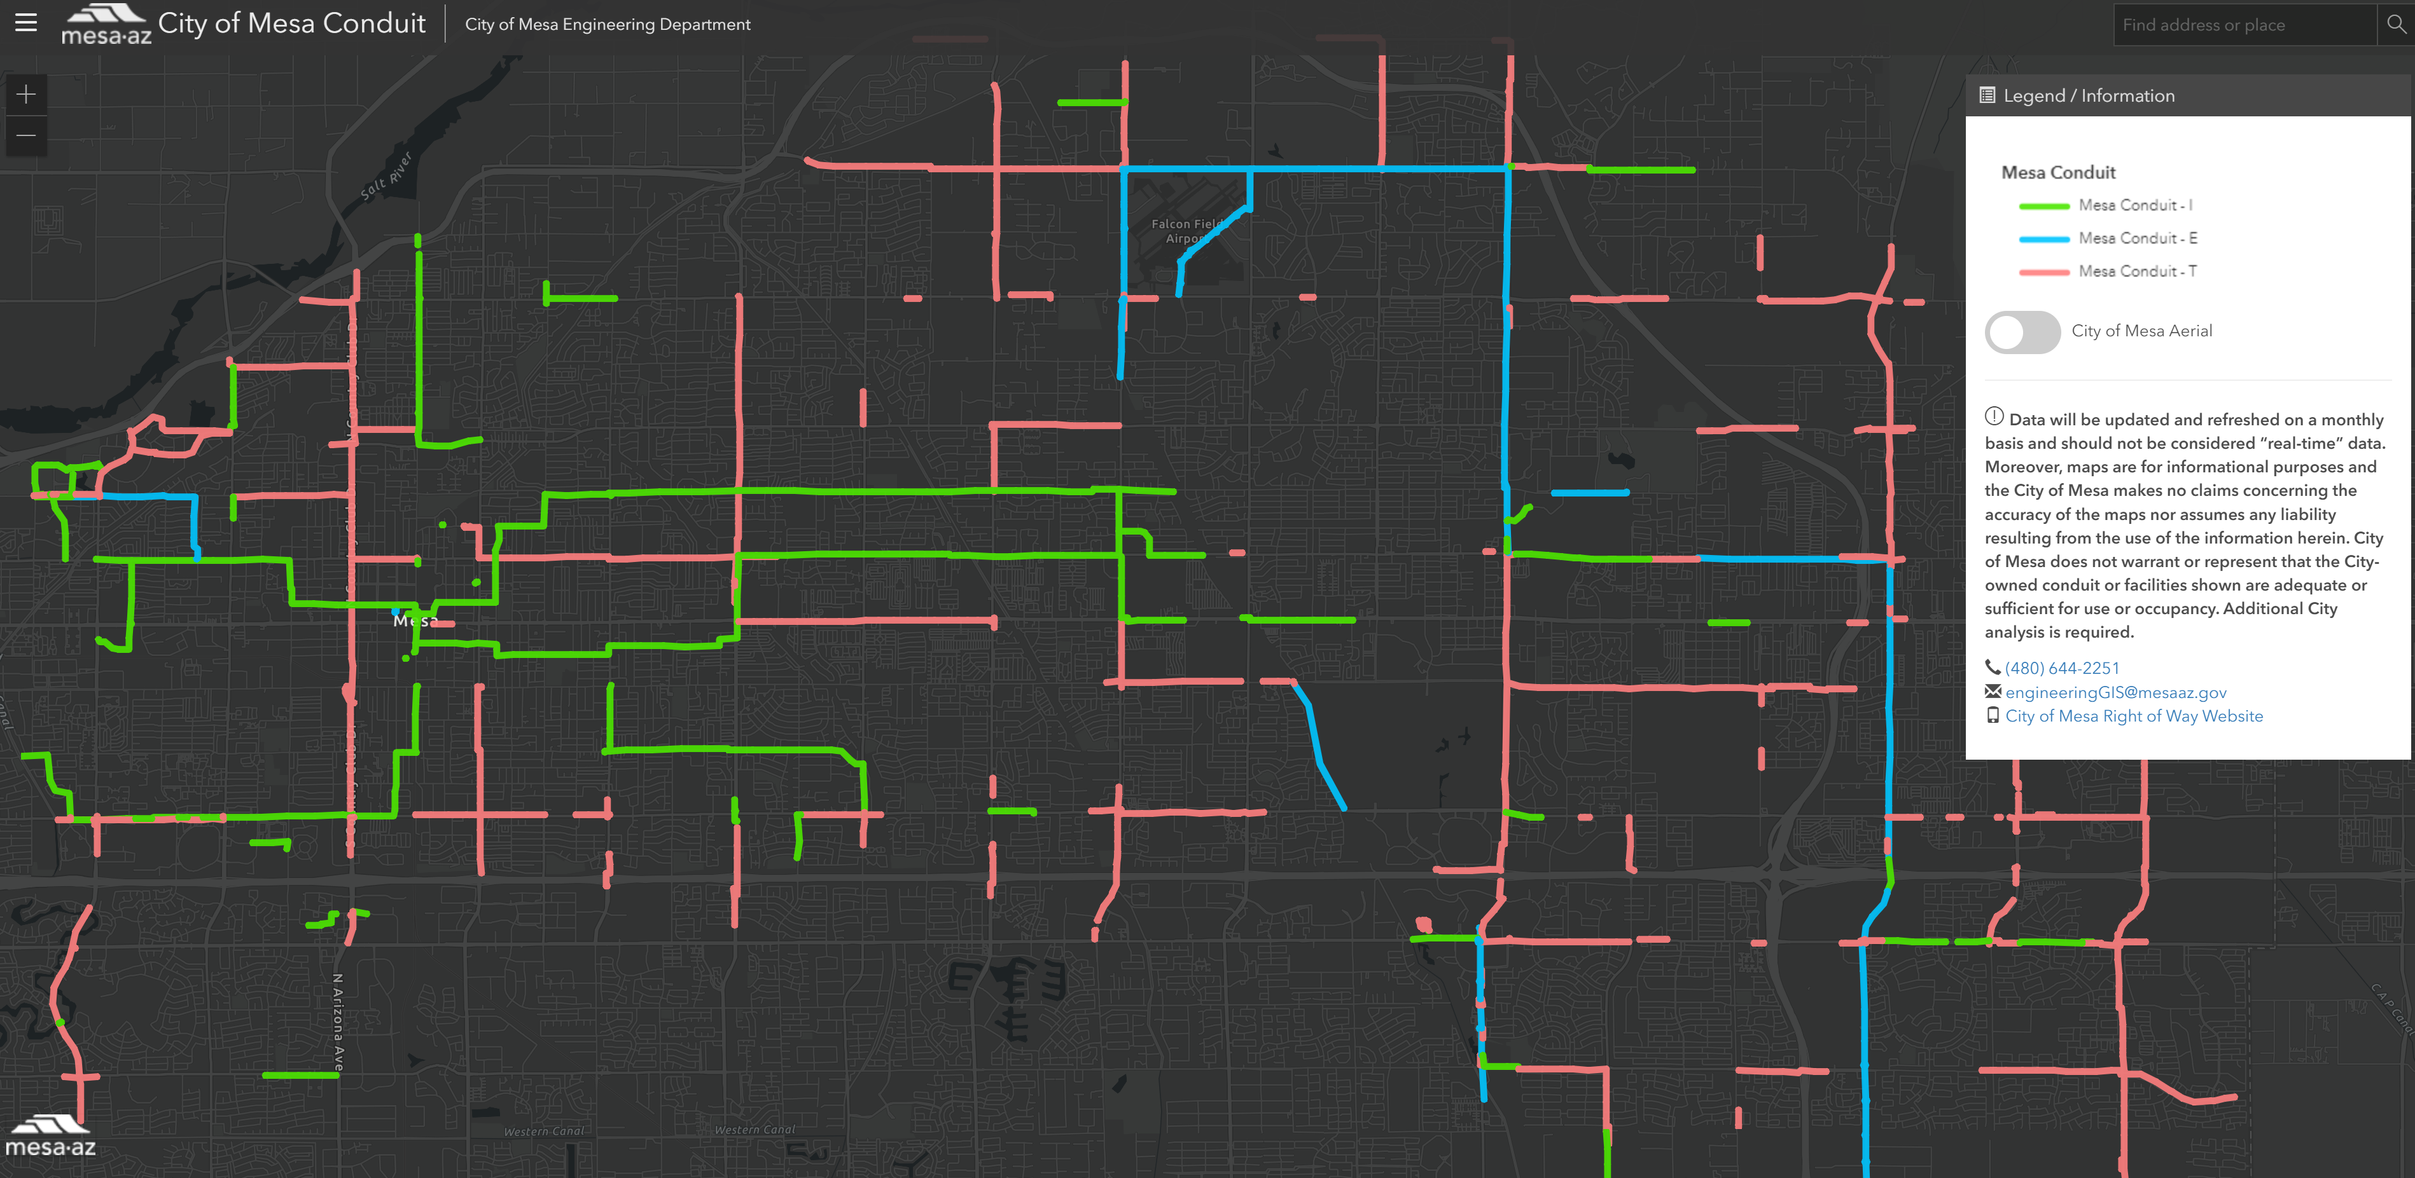
Conduit Rental

Slide 6
https://gis.mesaaz.gov/Html5Viewer/index.html?viewer=Broadband

Slide 7
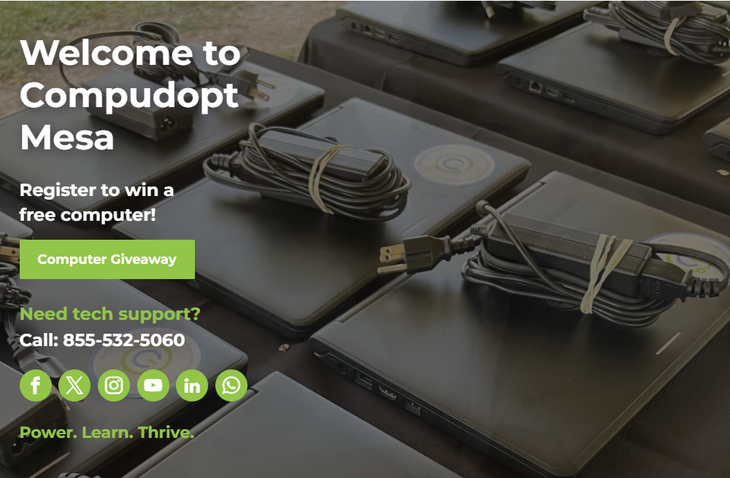

Slide 8
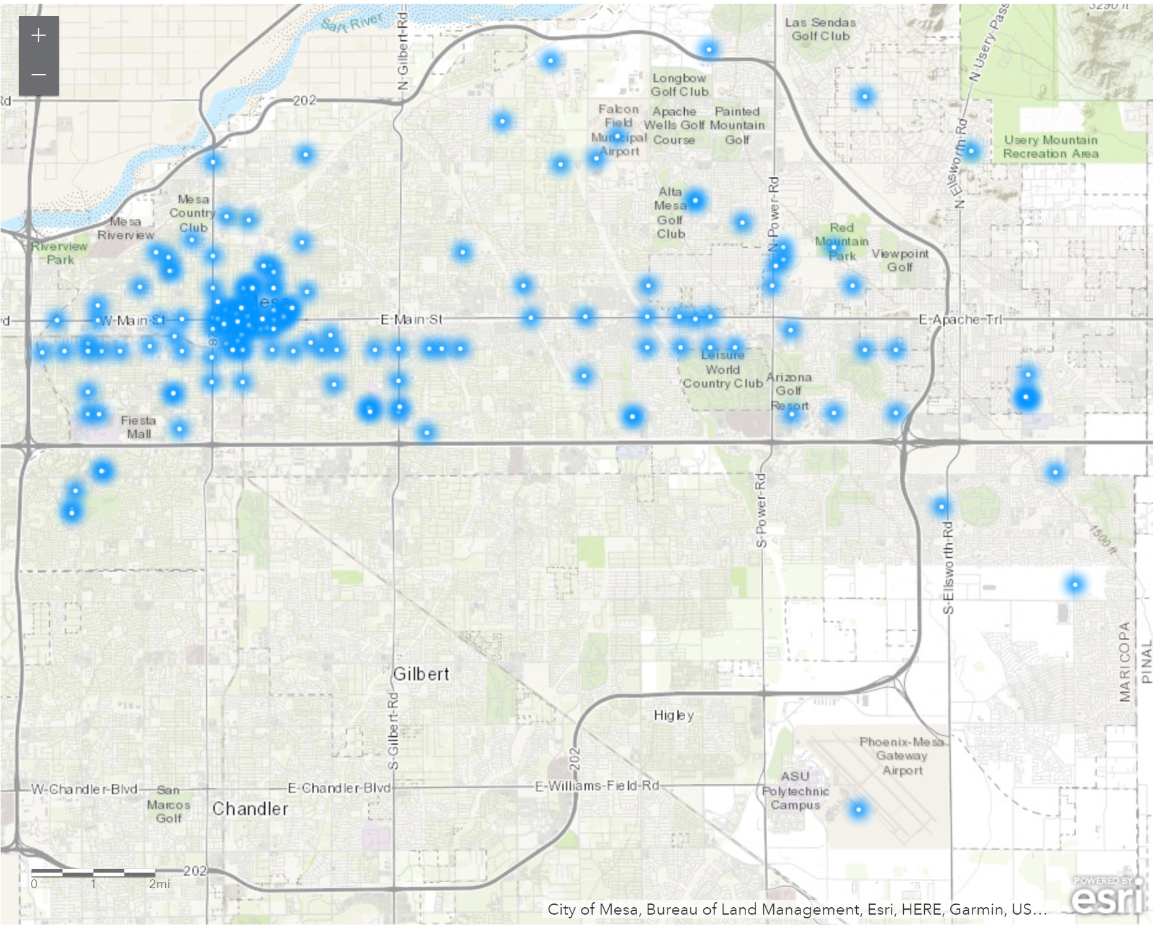
Current Map:
https://www.mesaaz.gov/government/mesa-free-wifi

Slide 9
Notes:
https://www.signify.com/global/innovation/brightsites/broadband-luminaires embed Siklu Terragraph gigabit mmWave tech inside a streetlight

