Slide 1
Arizona Department of Economic Security Poverty Reduction Tools

Slide 2
The War on Poverty
Source: U.S. Census Bureau, Current Population Survey, 1960 to 2018 Annual Social and Economic Supplements.

Slide 3
The U.S. poverty rate is 11.4%
Arizona’s poverty rate is 13.50%
Countywide poverty rates (2019 U.S. Census)
Apache 33.4%
Cochise 16.6%
Coconino 15.9%
Gila 21.1% Graham 20.1%
Greenlee 9.3%
La Paz 22.1%
Maricopa 12.2%
Mohave 16.0%
Navajo 25.2%
Pima 14.0%
Pinal 12.1%
Santa Cruz 18.8%
Yavapai 12.0%
Yuma 20.4%

Slide 4
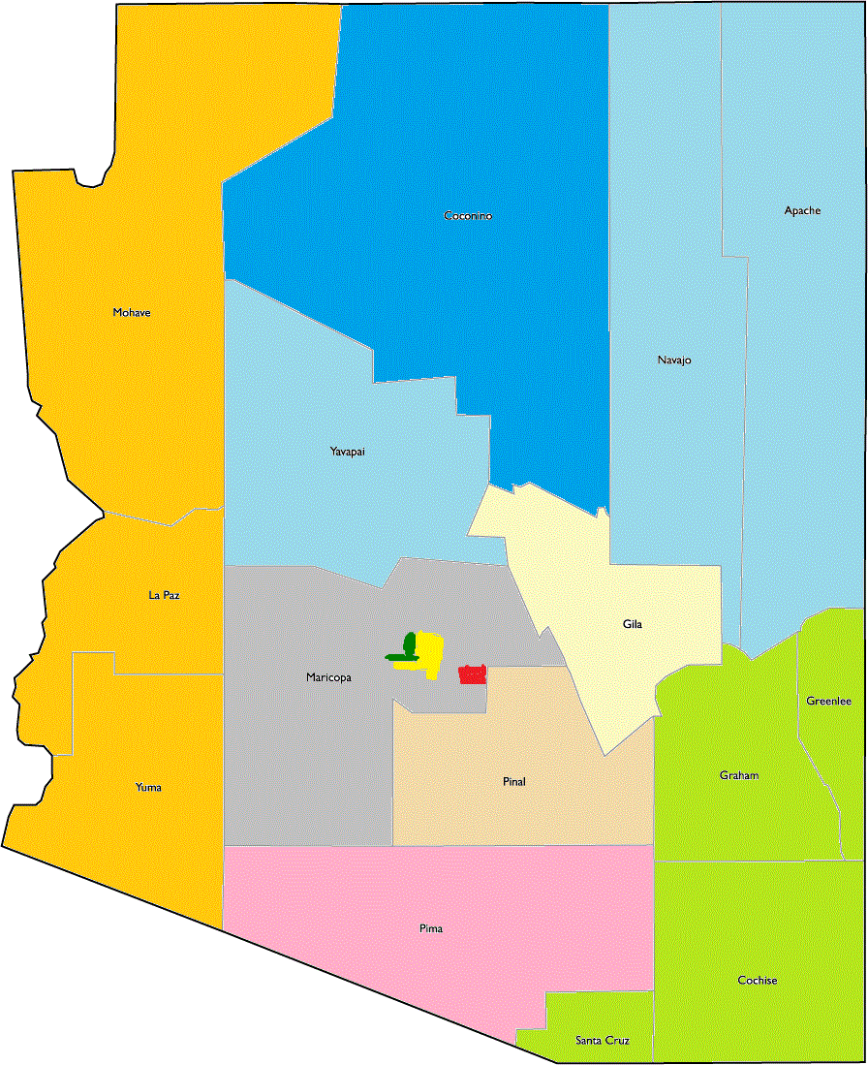
11 Community Action Agencies (CAAs) Serve All 15 Arizona Counties
Western Arizona Council of Governments
Coconino County
City of Glendale
Northern Arizona Council of Governments
City of Phoenix
Gila County
Mesa CAN
Community Action Human Resources Agency
Maricopa County
Pima County
Southeastern Arizona Community Action Program
Notes:
SPEAKER:
These are the eleven C A As that serve the fifteen counties of Arizona.
To see which areas the agency represents, click the name of the agency.
Please note there is a twelfth limited purpose agency, Portable Practical education preparation incorporated, which serves farmworkers statewide.
Click the Next button when you are ready to continue.
Edward/Andy – In the CBT, I plan on adding an optional animation that will show an arrow pointing to the geographic area for each CAA when one of the blue buttons is clicked.

Slide 5
Why CAAs are Unique
Most poverty-related organizations target specific types of need;
whereas
Community Action Agencies work to address any number of local needs through a comprehensive approach including partnerships with other community organizations
CAAs are permanently designated by States
CAAs’ governing boards consist of diverse sectors in the community
Notes:
SPEAKER:
A C A A is unique because rather than most poverty related organizations that focus on specific areas of need, (NOTE: 2nd text box will Fade in here) community action agencies work with their respective communities to address multiple needs through a comprehensive approach by developing partnerships with other community organizations.
It is the last part that is so very important.
(NOTE: 3rd text box will Fade in here) Creating and developing partnerships with other community organizations or private companies can greatly increase the impact the C A A can have on the community.
We will discuss the scope of that impact later in this presentation.

Slide 6
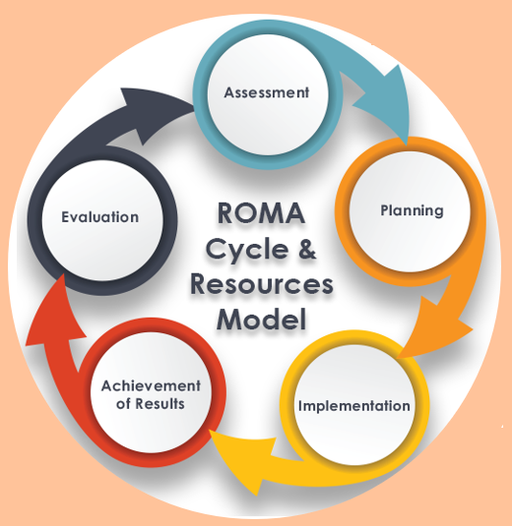
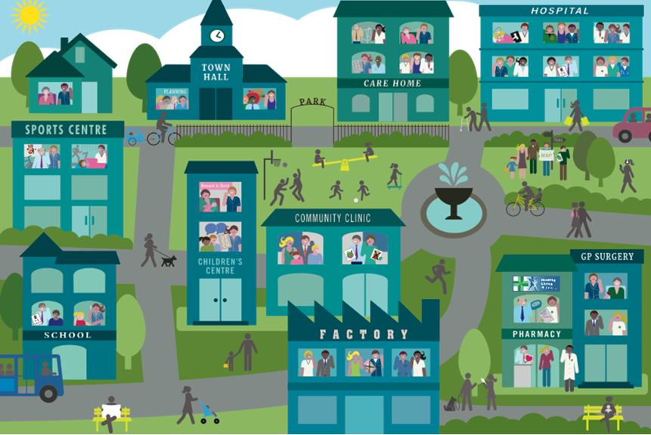
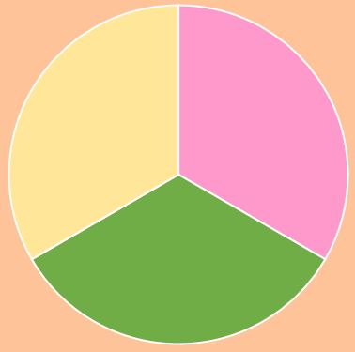
Key Elements of Community Action Agencies
Local solutions for local needs
Maximum feasible participation
Community
Agency
Performance management
Private Sector
Leveraging and partnerships
Notes:
Local solutions: triennial CAN requirement
Maximum participation: explain tripartite board in some detail
Performance management: ROMA, 58 organizational standards

Slide 7
LIHEAP
Low-Income Home Energy Assistance Program (LIHEAP)
Funds are administered by CAAs
Funds are used for consumer utility and housing emergencies
Utility payments and deposits
Utility shut-off prevention
Rent and deposits
Eviction prevention

Slide 8
CSBG
Community Service Block Grants (CSBG)
Funds are administered by CAAs
Provides assistance to state and local communities for the purpose of:
Reducing poverty
Revitalizing low-income communities
Empowerment of low-income families and individuals to become fully self-sufficient
CSBG funds are designed to serve as a catalyst
For every $1 of CSBG funding, Arizona’s CAAs leveraged $29.64 from federal, state, local and private sources

Slide 9
Why is DES Participating in the COVID-19 Digital Access Taskforce?
Over 982,600 Arizona residents 13.50% live in poverty
Nearly 13% of Arizonans do not have access to high-speed internet
Resulting in limited access to:
Education
Employment
Health care
Transportation
Etc.

Slide 10
Why is DES Participating in the COVID-19 Digital Access Taskforce?
CAAs wanted to increase the economic prosperity of low-income communities
CAAs wanted to bring broadband to low-income individuals and communities
CAAs are interested in partnering with anchor institutions and other broadband advocates
DES will serve as a catalyst between low-income consumers and communities, and broadband access
A list of CAA contacts can be found at: https://des.az.gov/services/basic-needs/community-action-agencies

Slide 11
Andy Sinclair
Arizona Department of Economic Security
Community Action Programs and Services
CAPS Capacity Development Coordinator
602-542-2562
asinclair@azdes.gov

