Slide 1
Welcome to the Fiber Future

Slide 2
Who Is ALLO
Founded in 2003
Ubiquitous City-Fiber Networks
Nelnet, Inc. / SDC Capital Partners
Competitive Fiber-to-the-Premise Provider
Pass 700,000+ Population
Bridgeport 1,500
2

Slide 3
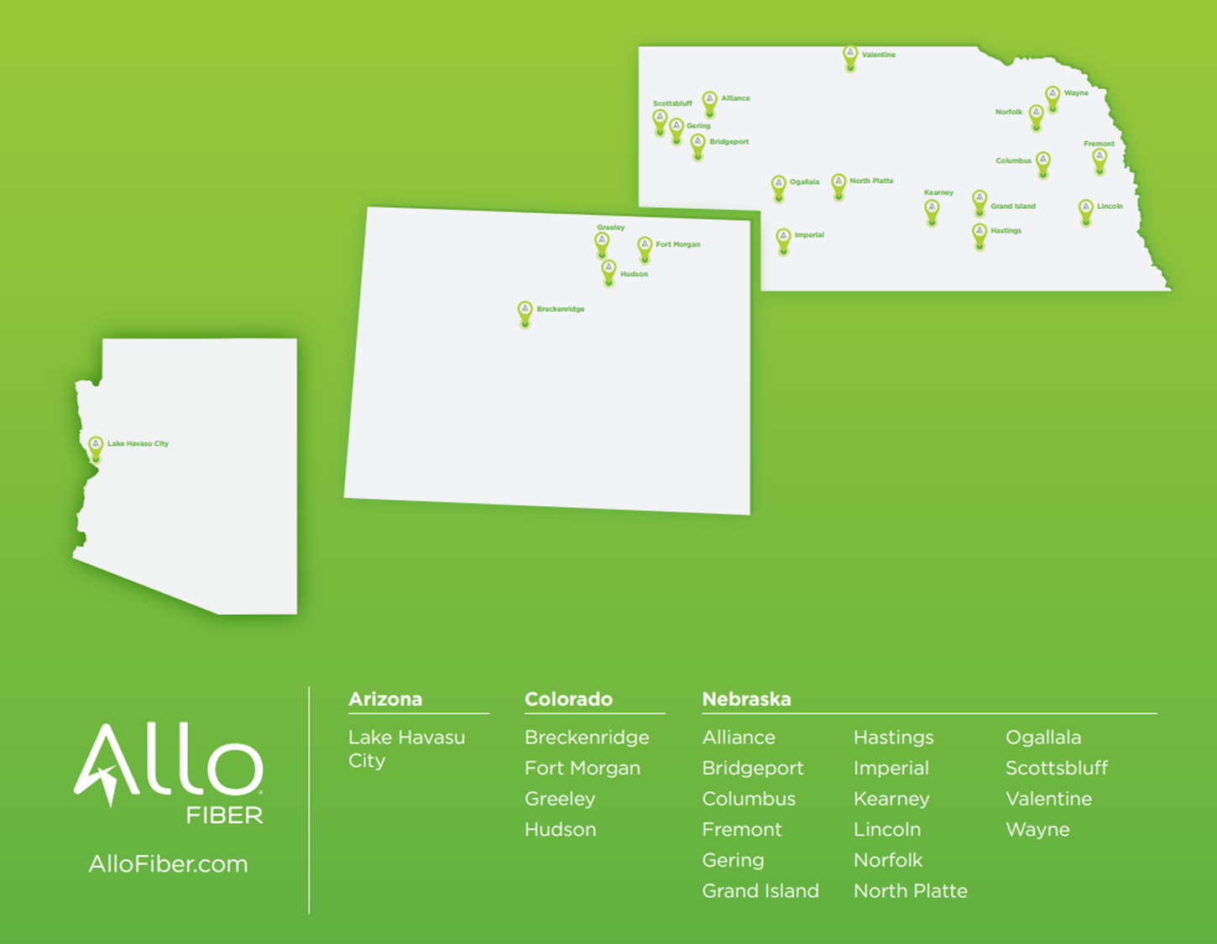
Valentine
Scottsbluff
Wayne
Alliance
Norfolk
Gering
Bridgeport
Columbus
Fremont
Ogallala
North Platte
Lincoln
Greeley
Imperial
Hastings
Fort Morgan
Hudson
Breckenridge
Nebraska
Alliance Lincoln Bridgeport Norfolk
Columbus * North Platte
Fremont * Ogallala
Gering Scottsbluff
Hastings Valentine*
Imperial Wayne *
* Planned for 2021
Colorado
Breckenridge Greeley*
Fort Morgan Hudson*
3

Slide 4
Who Is ALLO
LOCAL
Close Relationship with Communities
Local Employees
HASSLE-FREE
Efficient Construction Interval
Easy to Do Business
HONEST
Customers, Vendors, Associates
Fair, No Pricing Gimmicks
EXCEPTIONAL
Service Platform
Implementation of Technology
4

Slide 5
Who Is ALLO
Employees:
700+ (100+ in smaller communities)
Customers:
102,000+ (adding 500 every week)
Recognition / Awards:
2020 - Top 10 PC Magazine Fastest ISP
2020 National Ranking - Top 5 Fastest Internet Provider
2019 Chairman’s Award - Fiber Broadband Association
Current Communities:
1,500 to 290,000 in population
5

Slide 6
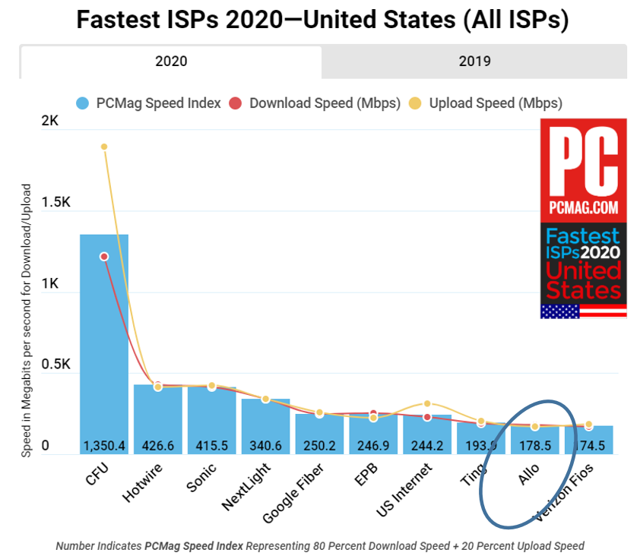
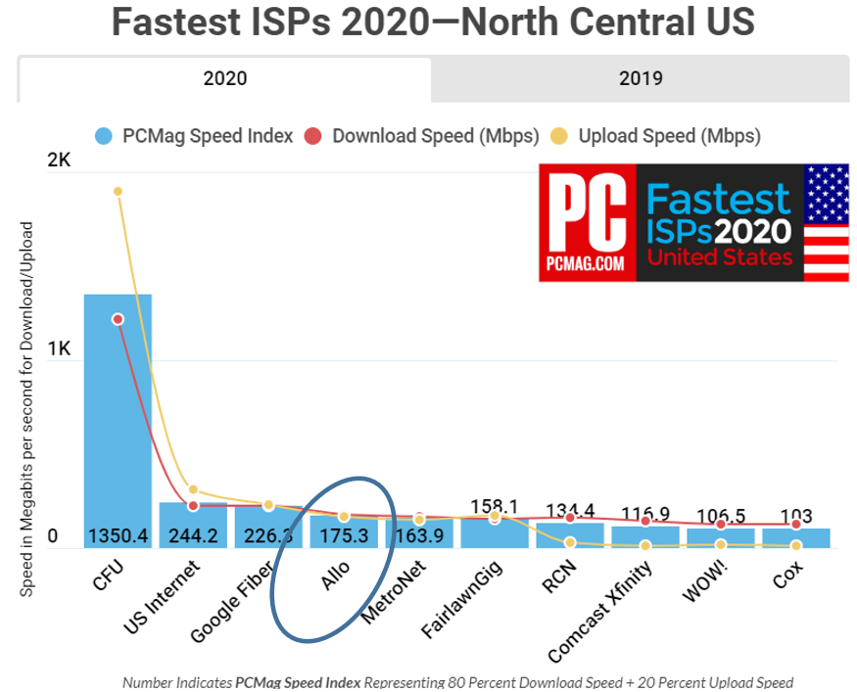
Fastest ISPs 2020
6

Slide 7
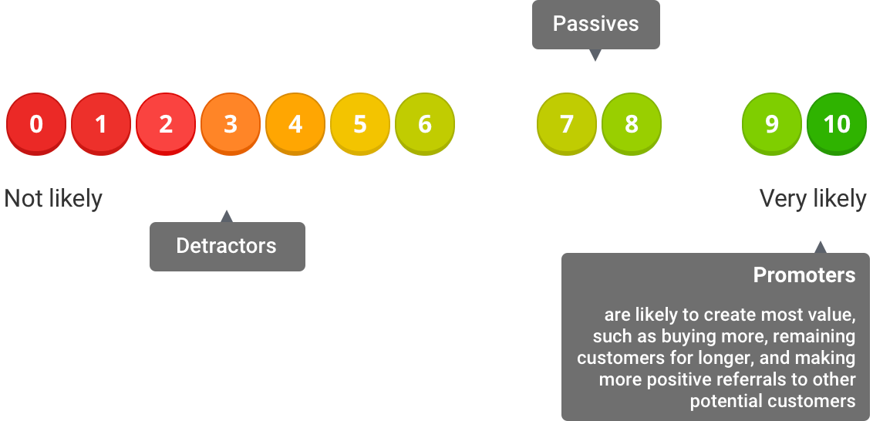
Net Promoter Scores
How likely are you to
recommend us to a friend?
68
0
-3
-6
https://customer.guru/net-promoter-score
NPS range of -100 to +100, a positive score above 0 is considered “good,” +50 is considered “excellent,” and 70 and above is considered “world-class.”
7

Slide 8
What is the ALLO Model?
Public Private Partnerships (3P)
Lincoln, NE
Fort Morgan, CO
Breckenridge, CO
Traditional Overbuild
Nebraska markets
Lowest risk for community
Other Models
Revenue bonds
Operate for others
ALLO Reduces Risk
Proven operator
Cost efficient construction
8

Slide 9
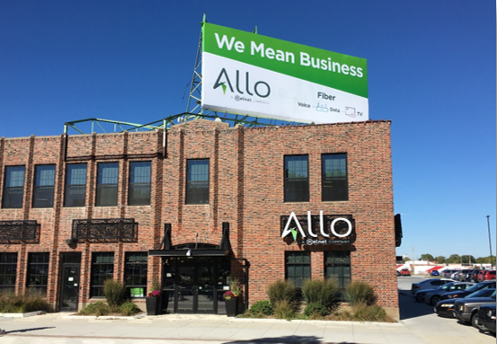
ALLO Case Study
Lincoln, NE in 2016
300 miles of conduit
8 million linear feet of fiber
3 year ubiquitous project build
Lincoln 28th fastest in Nebraska in
2015
2020 - 4th fastest in the country
(Top 100 cities)
9

Slide 10
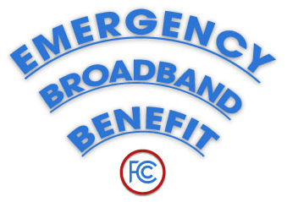
Helping Households Connect During the Pandemic
Emergency Broadband Benefit Program (EBB)
$3.2 billion federal initiative to help lower the cost of high-speed internet for eligible households during the ongoing COVID-19 pandemic
$50/month discount for broadband services
ALLO will make $20 contribution (no out-of-pocket-costs for recipients)
10

Slide 11
Residential Solutions
ALLO Fiber Internet
ALLO Fiber TV
ALLO Fiber Phone
Wireless router included (Wi-Fi 6)
50 Mbps, 500 Mbps, and 1 GIG download and upload (10 Gig)
Eliminate buffering
Connect 100+ devices simultaneously
Full channel lineup
Local stations
Wireless set-top boxes
Award-winning user interface
Keep existing number
Unlimited long distance
Voicemail and call waiting included
11

Slide 12
Business Solutions
Business Internet and MetroEthernet
Business Phone and Hosted PBX
Business TV
Synchronous internet speeds of 50 Mbps to 1 GIG+
Dependable, redundant connections minimize latency and jitter
Layer 2 connections up to 100 GIG
Remote work solutions
SIP, PRI, POTs, and full features at competitive prices
Hosted PBX systems with feature-rich solutions
Ericsson Mediaroom with 200+ channels
Customizable packages
12

Slide 13
New Market Process
New Market Process
Market Analysis and Selection
Competitive landscape
Community engagement
Efficiency of capital deployment (Hassle-Free)
Team Formation (Together)
Primary points of contact
Relationship building
Agreements
Cable Franchise Agreement
Construction Agreement
Pole Attachment Agreement
Design
Construct
Operate and Grow
13

Slide 14
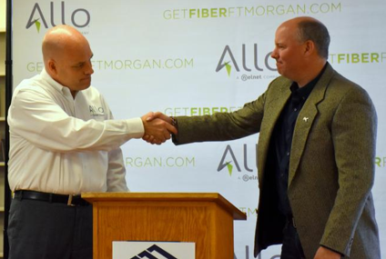
Design – Building Relationships
Every community design is different.
Local - ALLO designers collaborate with City GIS & Utility departments to confirm design preferences and rules, data sources, community preferences, and discuss upcoming major projects to minimize future rework.
Innovation – 1 GIG speeds available to every home and business.
Future Proof – XGS-PON and NG-PON2 compliant cabling offering 10 GIG speeds. Fiber cables have 40-50 year life span.
No Hassle – Minimal impact to neighborhoods through boring and aerial cable placements, staying in character of current utilities.
Simple – PON Grids based on 800-1000 customer locations. Centralized 32:1 splitters simplifying construction.
Fast – Auto designs completed in weeks, not months.
Safe – NEC and NESC compliant.
14
Notes:
Every community is different
Allo designers need to collaborate with your local experts on needs to be successful and produce the best designs
OSP partners with local experts on design routes to identify issues and future projects to eliminate rework

Slide 15
What Can You Do?
New Market Process
Bulk / Streamlined Permitting
Access to ROW
Use of Utility Poles
Co-Branding
Higher take-rate percentage
Relationship building
Property
Government owned land
Retail Storefront
Anchor Tenants
City buildings service
Set example
Market Data
Households, Parcel Info
Demographics, Growth Rate
Financial Incentives
Long-term financing
Grants
COVID Relief
Existing Assets
Dark fiber
In-kind contributions
15

Slide 16
Why ALLO
Local
Storefront
Service
Employee base
Economic
Investment in physical assets
Eliminates digital divide
Empower and assist in economic development
Ensure Your Community is Ready for the Future
16

Slide 17
A Proven Partner
Dwight ‘Doc’ Wininger, Director of External Relations
dwininger@allophone.net
Bob Beiersdorf, General Manager Western Region
rbeiersdorf@allophone.net
Tanna Hanna, Director of Marketing and Social Media
thanna@allophone.net
17

